Slide 1


Slide 2
WEEK 2 Prepared by Umar Niaz
Red Team Trainer at Cyberster

Slide 3
Week 02: Network Enumeration & Service Vulnerability Discovery
Task 01

Slide 4
Objective: To transition from broad reconnaissance to targeted network scanning, identifying open ports, and fingerprinting services while avoiding basic security triggers

Slide 5
Task 01: Advanced Network Scanning with Nmap
●Description: Move beyond basic ping sweeps to conduct deep-dive port scanning.
●Technical Requirements:
○ Perform TCP Connect scans (-sT) and SYN Stealth scans (-sS) and compare the results in terms of speed and visibility.
○ Conduct UDP Scanning (-sU) on the top 100 most common UDP ports (DNS, SNMP, DHCP).
○ Use Timing Templates (-T0 to -T5) to understand how scan speed affects reliability and detection.
●Learning Goal: Understand the mechanics of the TCP 3-way handshake and why Stealth scans are preferred in professional Red Teaming.

Slide 6
Task 1 Part 1:- Perform TCP Connect scans (-sT) and SYN Stealth scans (-sS) and compare the results in terms of speed and visibility.
3-Way Handshake
Client → SYN
Client asks (requests) to a server to open a (synchronization).
Server → SYN-ACK
Server acknowledges and offers to synchronize.
Client → ACK Client confirms. Connection established — data may flow.
Why it matters for Nmap:
-sT (TCP Connect) Completes the full 3-way handshake
A full connection is established
More likely to be logged by the target system
SYN Stealth Scan (-sS)
Sends SYN and receives SYN-ACK
Instead of completing the handshake, it sends RST
Connection remains half-open

Slide 7
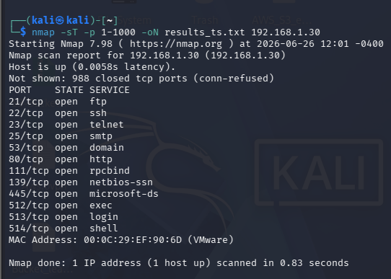
Target :- Metasploitable 2
nmap -sT -p 1-1000 -oN results_sT.txt <target>
What to record
Open ports and services reported
Scan duration (from nmap summary)
Any differences in service names compared to later scans
What to expect
Nmap will show ports as open/closed/filtered.
This scan completes full TCP sessions; target logs will often show connections.

Slide 8
2) SYN Stealth scan (-sS)
sudo nmap -sS -p 1-1000 -oN results_sS.txt <target>
What to record
Open ports and services reported
Scan duration
Any ports that appear in one scan but not the other
Interpretation
Typically -sS is faster and may show the same open ports as -sT.
If -sT shows additional ports, there may be inline filters/inspection
that treat full connects differently.

Slide 9
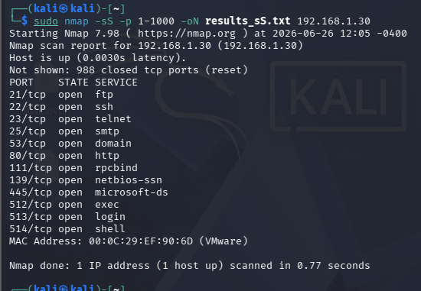

Slide 10
3) UDP scan (top 100 UDP ports)
sudo nmap -sU --top-ports 100 -oN results_udp.txt <target.com>
What to record
UDP ports returned as open, closed, or open | filtered
Scan duration (UDP scans are slower)
Any services (DNS, SNMP, NTP) discovered
Notes
UDP is stateless: no handshake, so absence of response often means
Open | filtered.
Be patient; UDP scans can take much longer and may require retries.

Slide 11
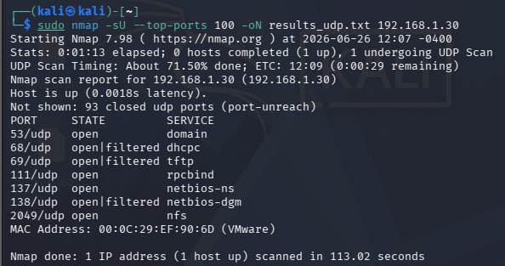

Slide 12
4) Timing templates (-T2 vs -T4)
Commands (SYN example)
sudo nmap -sS -T2 -p 1-1000 -oN sS_T2.txt <target>
sudo nmap -sS -T4 -p 1-1000 -oN sS_T4.txt <target>
What to record
Duration for each run
Any differences in ports reported
Whether the faster scan missed anything or produced inconsistent results
-T2 → slower, more polite (stealthier)
-T4 → aggressive (faster but noisier, more likely to trigger alarms)

Slide 13
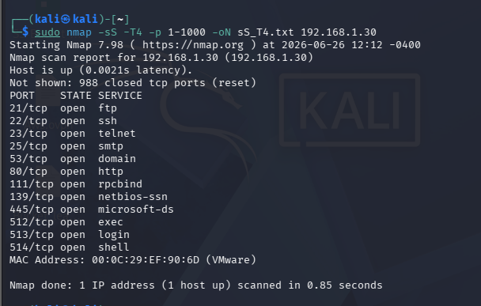
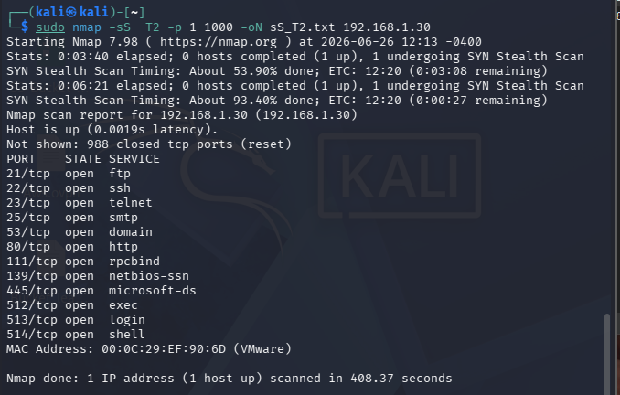

Slide 14
Scan | Command | Time Taken | Open Ports
Slow | -T2
Normal | -T3
Fast | -T4
Template | Name | Behavior
-T0 | Paranoid | Extremely slow
-T1 | Sneaky | Very slow
-T2 | Polite | Slow, reduces network load
-T3 | Normal | Default timing
-T4 | Aggressive | Faster scanning
-T5 | Insane | Very fast but less reliable

Slide 15
Task 02

Slide 16
Task 02: Service Fingerprinting & Banner Grabbing
Description: Identify the exact versions of services running on open ports to look for known vulnerabilities.
● Technical Requirements:
○ Use Nmap’s Version Detection (-sV) and Aggressive Scan (-A) flags to identify service details.
○ Perform Manual Banner Grabbing using Netcat (nc) or Telnet to verify service headers.
○ Use Enum4linux or Samba tools if SMB (Port 445) is found open to list shares and users.
● Learning Goal: Realize that a service version is the primary "key" to finding a specific exploit (CVE).

Slide 17
In Task 01, we enumerated the attack surface by identifying live hosts and exposed ports. However, an open port alone provides limited intelligence. Before we can assess a service for weaknesses, we must accurately identify the software running on that port and determine its exact version. This process is known as service fingerprinting.
Nmap's Version Detection (-sV) performs active service fingerprinting by sending a series of protocol-specific probes to each open port and analyzing the responses. These responses are then compared against Nmap's service fingerprint database to identify the service, its underlying software implementation, and, where possible, its exact version.
The objective is not merely to determine that port 80 is running HTTP or port 22 is running SSH. The objective is to identify the actual software—for example, Apache HTTP Server 2.2.8 or OpenSSH 4.7p1—because vulnerability assessment is performed against specific software implementations and versions, not simply against port numbers or protocol names.
With this understanding, we will now use Nmap's Version Detection (-sV) to fingerprint the services running on our target and analyze the information it reveals.
☠

Slide 18
Part 1 — Service Version Detection with Nmap and Aggressive Scan
Nmap can automatically detect the service name and version running on open ports.
nmap -sV <target>
Example
nmap -sV 192.168.100.246
Example Output
PORT STATE SERVICE VERSION
22/tcp open ssh OpenSSH 7.6p1 Ubuntu
80/tcp open http Apache httpd 2.4.29

Slide 19
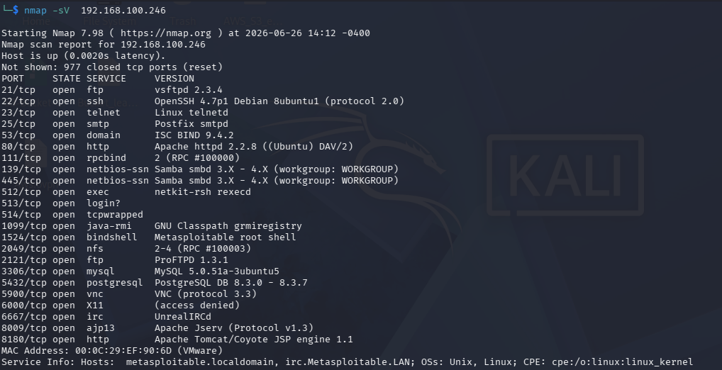
Host is up (0.0020s latency)
Nmap confirmed the target is reachable.
The latency is approximately 2 ms,
indicating the target is very close on the
network (which is expected in a virtual lab).
22/tcp open ssh OpenSSH 4.7p1 Debian 8ubuntu1
Don't read it literally.
Interpret it.
Nmap has determined:
SSH service is running.
The implementation is OpenSSH.
Version 4.7p1.
Debian/Ubuntu package build 8ubuntu1.
The server supports SSH Protocol 2.0.
Notice how much intelligence came from one line.
Look for Anomalies
Some entries immediately stand out.
Examples:
513/tcp login?
The question mark means Nmap couldn't confidently identify the service

Slide 20
Record these:-
Open ports
Service name
Service version
Aggressive Scan
Nmap provides a more detailed scan using the Aggressive mode.
What information do we already have from the previous task?
Live host
Open ports
Is knowing only that port 80 is open enough?"
No.
We need to know
Which web server?
Which version?
Which operating system?
Any additional information?
That is exactly what - A does.
-A is not a single feature.
nmap -A <target>
What -A Does
It enables several advanced features:
Feature | Purpose
OS Detection | Attempts to identify the operating system
Version Detection | Identifies service versions
Script Scanning | Runs default Nmap scripts
Traceroute | Shows network path

Slide 21
Example
sudo nmap -A 192.168.100.24
What to look for
Operating system guess
Additional service details
Extra script results
Port | Service | Version
22 | SSH | OpenSSH 7.6p1
80 | HTTP | Apache 2.4.29

Slide 22
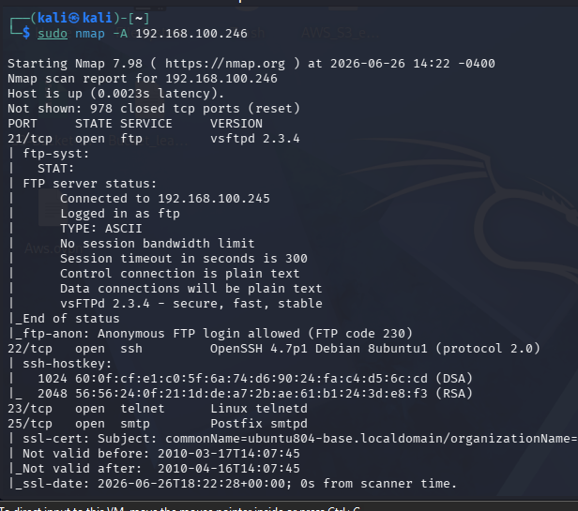
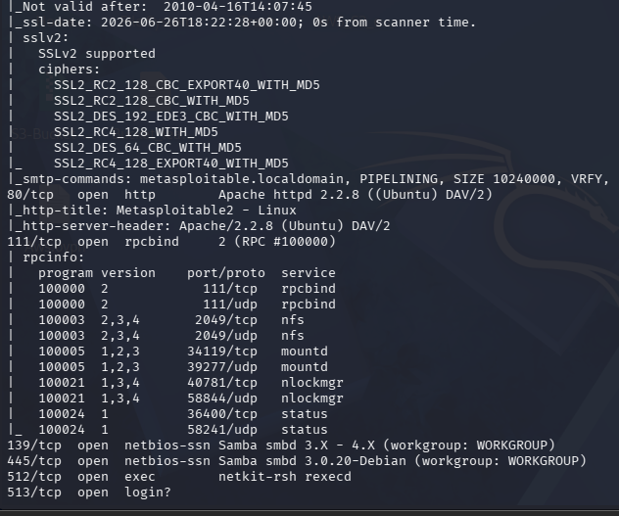

Slide 23
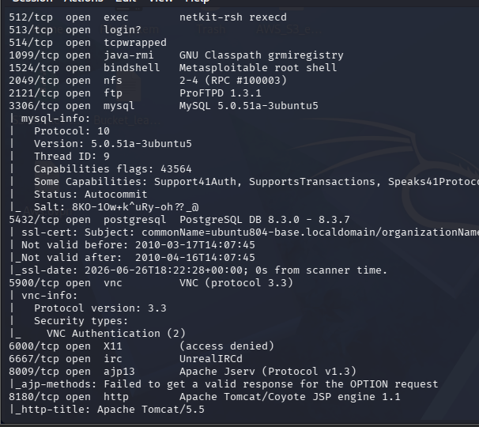
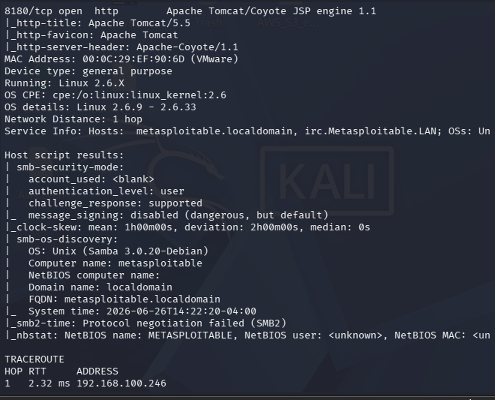

Slide 24
What we got
Service | Connect | Command(s) after connecting | Purpose
FTP (21) | nc <target> 21 | USER anonymous → PASS anonymous → SYST → FEAT → QUIT | View banner, test anonymous login, identify OS and supported FTP features.
SSH (22) | nc <target> 22 | None | SSH sends its identification banner automatically (e.g., SSH-2.0-OpenSSH_4.7p1...).
Telnet (23) | nc <target> 23 | None (or press Enter) | Observe the login prompt/banner.
SMTP (25) | nc <target> 25 | EHLO kali → HELP → QUIT | Enumerate SMTP capabilities and server banner.
DNS (53) | Netcat is not suitable | Use dig, host, or nslookup | DNS uses a binary protocol, so banner grabbing isn't practical with Netcat.
HTTP / Apache (80) | nc <target> 80 | HEAD / HTTP/1.0 (press Enter twice) | Retrieve HTTP response headers, including the Server header.
RPCBind (111) | Netcat is not suitable | Use rpcinfo -p <target> | RPC uses a binary protocol; rpcinfo is the appropriate tool.
Samba (139/445) | Netcat is not suitable | Use smbclient or enum4linux | SMB negotiation is binary and not practical with raw Netcat.
Java RMI (1099) | nc <target> 1099 | None | Usually no readable banner; specialized RMI tools provide better results.
Bind Shell (1524) | nc <target> 1524 | whoami, id, uname -a, exit | Interact with the shell if one is exposed (appropriate only in your authorized lab).
NFS (2049) | Netcat is not suitable | showmount -e <target> | Enumerate exported NFS shares.
ProFTPD (2121) | nc <target> 2121 | USER anonymous → PASS anonymous → SYST → FEAT | Same FTP commands as port 21.
MySQL (3306) | nc <target> 3306 | None | The MySQL handshake packet is sent automatically and includes version information.
PostgreSQL (5432) | nc <target> 5432 | None | Usually produces binary startup data; psql is better for interaction.
VNC (5900) | nc <target> 5900 | None | The server immediately advertises its RFB protocol version.
IRC (6667) | nc <target> 6667 | NICK test → USER test 0 * :Test User | Initiate the IRC protocol and receive server messages.

Slide 25
Part 2 — Manual Banner Grabbing
Manually check a service to see what information it reveals.
banner is the information a server sends when a connection is established
Example banner
220 ProFTPD 1.3.5 Server ready
This tells us:
Service → FTP
Software → ProFTPD
Version → 1.3.5
Method 1 — Using Netcat
nc <target> <port>
Example
nc 192.168.1.17 21
Then type for FTP:
USER anonymous Because from the output of Part 1 of Aggressive scan we have sudo nmap -A 192.168.100.24
PASS anonymous
SYST
FEAT
QUIT
Service | Manual Connection | Command(s) | Expected Banner
FTP | nc <target> 21 | (none initially), USER anonymous | 220 (vsFTPd 2.3.4)
SSH | nc <target> 22 | (none) | SSH-2.0-OpenSSH_4.7p1 Debian-8ubuntu1
SMTP | nc <target> 25 | EHLO test | 220 ... Postfix
HTTP (Apache) | nc <target> 80 | HEAD / HTTP/1.0 | Server: Apache/2.2.8
MySQL | nc <target> 3306 | (none) | MySQL handshake packet containing the version
PostgreSQL | nc <target> 5432 | (none) | PostgreSQL startup response
IRC | nc <target> 6667 | (none) | UnrealIRCd banner
Tomcat | nc <target> 8180 | HEAD / HTTP/1.0 | Apache-Coyote server header
Port | Service | Version | Notes
21 | FTP | vsftpd 2.3.4 | Anonymous login enabled

Slide 26
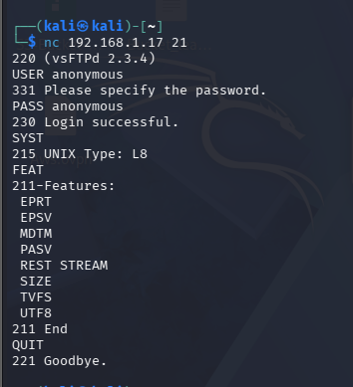

Slide 27
Command / Response | Meaning
220 (vsFTPd 2.3.4) | Server Banner. The FTP server is ready to accept a connection. It also reveals the software (vsFTPd) and version (2.3.4).
USER anonymous | Sent by the client to specify the username for login. Here you're attempting an anonymous login.
331 Please specify the password. | The server accepted the username and is requesting a password.
PASS anonymous | Sent by the client to provide the password. For anonymous FTP, this is often any value or an email address.
230 Login successful. | Authentication succeeded. You are now logged in to the FTP server.
SYST | Requests the server's operating system information.
215 UNIX Type: L8 | The server reports it is a UNIX-like system using 8-bit bytes (Type L8).
FEAT | Requests a list of FTP features/extensions supported by the server.
211-Features: | Beginning of the supported feature list.
EPRT | Extended Port command (supports IPv4/IPv6 active mode).
EPSV | Extended Passive Mode (recommended for IPv4/IPv6).
MDTM | Allows querying a file's last modification time.
PASV | Passive Mode support for data transfers.
REST STREAM | Supports resuming interrupted file transfers.
SIZE | Returns the size of a file.
TVFS | Trivial Virtual File Store support (standardized virtual filesystem).
UTF8 | Supports UTF-8 file and directory names.
211 End | End of the feature list.
QUIT | Client requests to terminate the FTP session.
221 Goodbye. | Server confirms the connection has been closed.

Slide 28
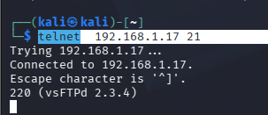
Method 2 — Using Telnet
telnet <target> <port>
Example:
telnet 192.168.1.17 21
Then type:
USER anonymous
PASS anonymous
SYST
FEAT
QUIT
Domain information

Slide 29
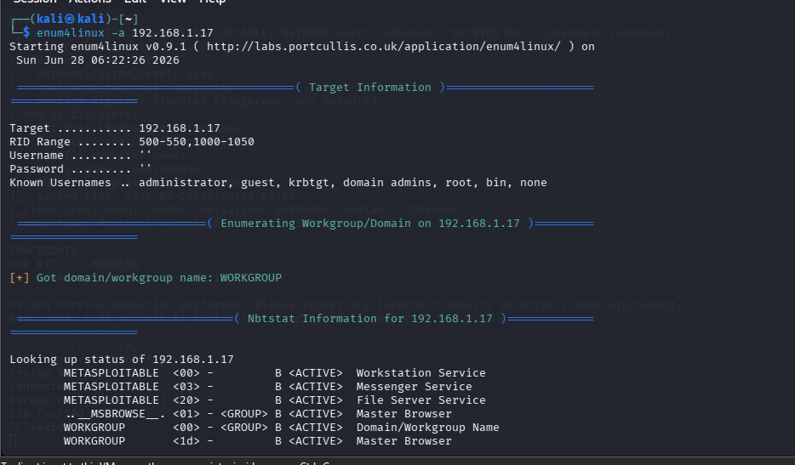
Part 3 — SMB Enumeration (If Port 445 Is Open)
If Port 445 is open, it usually indicates SMB
(Windows File Sharing).
We can use Enum4linux to gather information.
enum4linux -a <target>
What Enum4linux Can Discover
Shared folders
Users
Groups
Sharename | Type | Comment
ADMIN$ | Disk | Remote Admin
Public | Disk
IPC$ | IPC

Slide 30
Task 03: Leveraging Nmap Scripting Engine (NSE)
Description:
Use automated scripts to detect vulnerabilities and misconfigurations during the scan.
Technical Requirements:
○ Run scripts from the 'Discovery' and 'Safe' categories to find additional info (e.g., http-enum, ssl-cert).
○ Execute the 'Vuln' category scripts (--script vuln) on a target machine to identify exploitable vulnerabilities.
○ Map the NSE output to specific CVE IDs.
● Learning Goal:
Automate the repetitive parts of vulnerability discovery while maintaining
control over the scan.

Slide 31
The Nmap Scripting Engine (NSE) contains scripts that help gather additional information about services
running on a target system.
Example 1 — HTTP Enumeration
If Port 80 (HTTP) is open, we can run the http-enum script.
nmap -p 80 --script http-enum <target>
What the Script Does
The script searches for common web directories and pages.
Example output:
/admin
/login
/uploads
/images
These directories may reveal hidden functionality or administrative panels.
Category | Purpose
discovery | Collects extra information about services
safe | Performs checks that are unlikely to disrupt services

Slide 32
Nmap can also run all scripts in a category.
Discovery scripts
nmap --script discovery <target>
Safe scripts
nmap --script safe <target>
These scans may collect information such as:
service details
DNS data
HTTP headers
network configuration

Slide 33
Example 2 — SSL Certificate Information
If Port 443 (HTTPS) is open, we can retrieve SSL certificate details.
nmap -p 443 --script ssl-cert <target>
Example Output
Subject: commonName=example.com
Issuer: Let's Encrypt
Public Key type: RSA
This information can reveal:
domain ownership
certificate issuer
certificate validity
Run all scripts:-
nmap --script discovery <target>
Safe scripts
nmap --script safe <target>

Slide 34
Task 3 Part 2
Running Vulnerability Scripts
Basic Command
nmap --script vuln <target>
This command runs all scripts in the vulnerability category against the target.
It is usually helpful to combine vulnerability scanning with
service version detection.
sudo nmap -sV --script vuln <target>

Slide 35
Task 03 – Part 3
Mapping NSE Output to CVE IDs
Description
When Nmap vulnerability scripts detect a potential weakness, they often include a CVE ID in the output.
A CVE (Common Vulnerabilities and Exposures) ID is a unique identifier assigned to a publicly known security vulnerability.
Example NSE Output
After running a vulnerability scan:
sudo nmap -sV --script vuln <target>
Understanding the CVE ID
Example:
CVE-2017-5638
Breakdown:
Part | Meaning
CVE | Common Vulnerabilities and Exposures
2017 | Year the vulnerability was published
5638 | Unique vulnerability identifier

Slide 36
How to Look Up a CVE
Examples:
NIST National Vulnerability Database
https://nvd.nist.gov
MITRE CVE Database
https://cve.mitre.org
Example search:
CVE-2017-5638
The database will provide:
vulnerability description
affected software versions
severity score (CVSS)
mitigation recommendations
Port | Service | Version | CVE ID | Description
80 | Apache HTTP | 2.4.29 | CVE-2019-0211 | Privilege escalation vulnerability
445 | SMB | SMBv1 | CVE-2017-0144 | EternalBlue vulnerability

Slide 37
Task 04
Task 04: Stealth & Firewall Evasion Techniques
Description: Practice techniques to bypass basic Intrusion Detection Systems (IDS) or Firewalls.
Technical Requirements:
○ Use Packet Fragmentation (-f) and MTU manipulation to slip past simple packet filters.
○ Experiment with Decoys (-D) to hide your actual IP address among a crowd of "fake" scanning IPs.
○ Use Source Port Spoofing (--source-port) to bypass firewalls that only allow traffic from specific ports (like DNS/53).
Learning Goal: Learn that "Loud" scans get blocked; "Quiet" and "Creative" scans get results.

Slide 38
Stealth & Firewall Evasion Techniques
Description
Some network defenses such as basic firewalls or intrusion detection systems (IDS) look for
patterns in packets to detect scans. Security testers sometimes adjust how packets are sent to
understand how these defenses react.
Experiment with packet fragmentation and MTU size adjustments in Nmap to
see how scan behavior changes.
Concept: Packet Fragmentation
Normally, a network packet is sent as one piece.
With fragmentation, the packet is broken into smaller fragments before being sent.
Very simple packet filters may inspect only the first fragment, which can sometimes make detection harder.
Modern security systems usually reassemble packets, so this technique mainly demonstrates how packet handling works
Technique 1 — Packet Fragmentation (-f)
sudo nmap -sS -f <target>
What it does
Splits the scan packets into smaller fragments.
Helps demonstrate how packet inspection systems handle fragmented traffic.
Scan Type | Command | Result
Normal scan | nmap -sS <target> | Open ports found
Fragmented scan | nmap -sS -f <target> | Compare results

Slide 39
Technique 2 — MTU Manipulation
MTU (Maximum Transmission Unit) controls the size of packets sent over a network.
Changing MTU alters how packets are divided during transmission.
Example Command
sudo nmap -sS --mtu 16 <target>
What this means
Forces packets to be very small
Causes the network stack to fragment packets differently
Perform three scans against an authorized lab target.
1. Normal SYN scan
sudo nmap -sS <target>
2. Fragmented packet scan
sudo nmap -sS -f <target>
3. MTU manipulation scan
sudo nmap -sS --mtu 16 <target>
Record these
Scan Type | Command | Scan Time | Ports Found | Notes
Normal | -sS
Fragmented | -sS -f
MTU modified | --mtu

Slide 40
Task 04 – Part 2
Decoys and Source Port Manipulation
Technique 1 — Decoy Scanning (-D)
Decoy scanning makes it appear as though multiple systems are performing the scan.
Instead of one IP sending packets, Nmap inserts decoy IP addresses along with the real scanner.
sudo nmap -sS -D RND:5 <target>
This causes the target to see traffic coming from multiple IP addresses,
making it harder to determine which one is the real scanner.
sudo nmap -sS -D RND:10 <target>
The target system may see scan packets appearing to come from 10 different addresses.
Technique 2 — Source Port Manipulation
Some firewalls allow traffic from trusted ports such as:
Option | Purpose
-D | Enables decoy scanning
RND:5 | Generates 5 random decoy IP addresses
-sS | SYN scan
Port | Service
53 | DNS
80 | HTTP
443 | HTTPS

Slide 41
Nmap allows the scan to appear as if it originates from a specific port.
sudo nmap -sS --source-port 53 <target>
This helps demonstrate how simple firewall rules based only on ports can be bypassed in controlled tests.
Normal SYN Scan
sudo nmap -sS <target>
Decoy Scan
sudo nmap -sS -D RND:5 <target>
Source Port Scan
sudo nmap -sS --source-port 53 <target>
Option | Purpose
--source-port | Sets the source port used in the scan
53 | Makes packets appear as DNS traffic

Slide 42
What to record
Notes → observations or comments
Weekly Deliverable: The Scanning & Enumeration Report
Nmap Output Analysis: Screenshots and explanations of the open ports found.
Service Table: A clean table listing: Port, Service Name, Version, and Potential Vulnerabilities.
Evasion Results: A short write-up on which stealth flags worked and which were potentially "noisy."
Actionable Insights: Which port/service is the most likely "Initial Access" point and why?
Scan Type | Command | Scan Time | Ports Found | Notes
Normal Scan | -sS
Decoy Scan | -D
Source Port Scan | --source-port

Slide 43
Thank you

